Slide 1
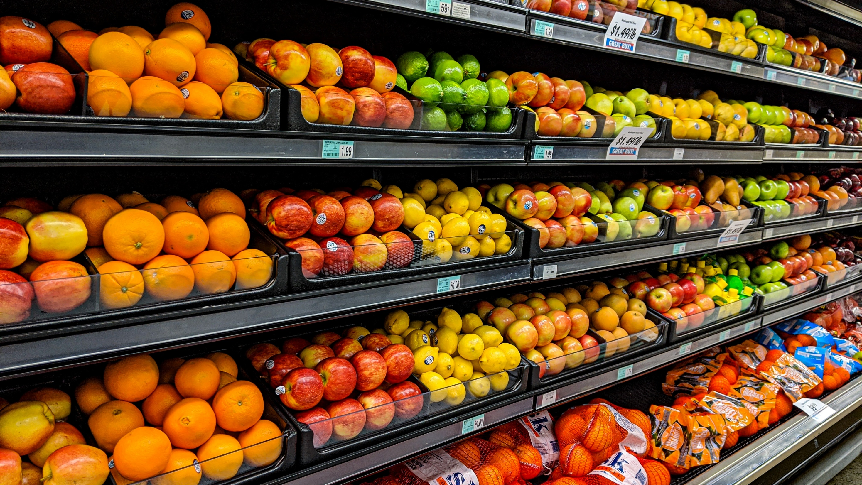

Prediction of supermarket sales to reduce food waste
Cloud Computing I Presentation: Group 3 – 05.12.2025

Slide 2
The presentation is focused on 6 main parts
Agenda
3
1. Business need
5
3. Model explanation
7
4. AWS infrastructure
11
5. Live demonstration
12
6. Key takeaways

Slide 3
1
Business need

Slide 4
Progress on reducing perishable good waste is slowing
1. Business need
Perishable food waste of UK retailers per year (in k tonnes)
Description
Retailers are relying on good forecasts to buy the right amount of goods to avoid overstocking or selling out
Good sales forecasts require well-trained models to buy just the right amount of goods
These models need reliable data which includes aspects such as unique needs, new products, seasonal tastes, marketing etc.
-5%
2018
2019
2020
2021
2022
2023
The waste of perishable goods from supermarkets can be reduced by better forecasting the actual demand to avoid overstocking using an easily accessible ML model
Sources: Numan (2024)

Slide 5
2
Model explanation

Slide 6
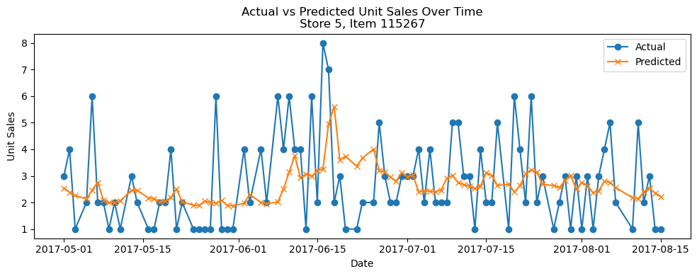
Model was trained offline in 7 steps
2. Model explanation
Most important steps of the model creation
Performance metrics
1
Subsampling & modelling tables: Random sampling to handle size and merge of main sales data
RMSE
MAE
R²
9.89
3.45
0.74
2
Time-based & lag feature engineering: Transform raw daily sales into richer time-series feature set
3
Target definition & split: Define time-based unit sales and target and train/validation split
Prediction of sales vs actual sales
4
Preprocessing pipeline with ColumnTransformer: Transforming of numeric and categorical features
5
Model zoo and hyperparameter grids: Ridge & Lasso regression, RandomForest, XGB, LGBRegressor
6
Model selection: GridSearchCV searches over the hyperparameter grid
7
Final model training and test prediction: Refitting of best model and generation of predictions

Slide 7
3
AWS Infrastructure

Slide 8
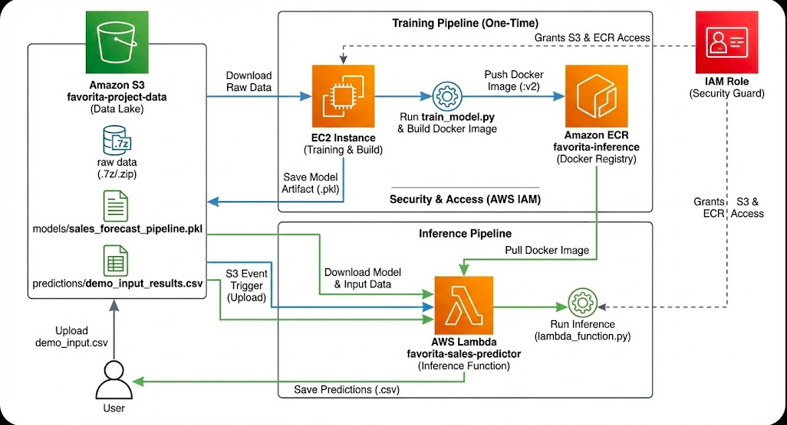
Overview of the AWS Infrastructure
3. AWS infrastructure

Slide 9
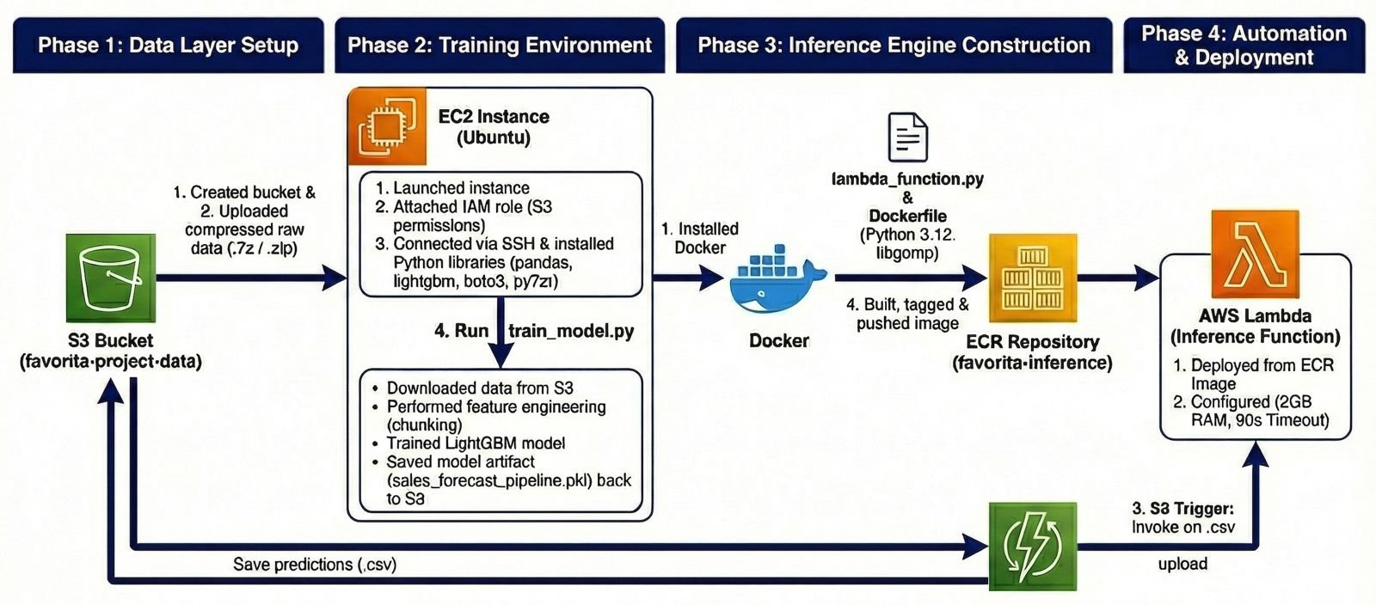
The development process can be divided into four phases
3. AWS infrastructure

Slide 10
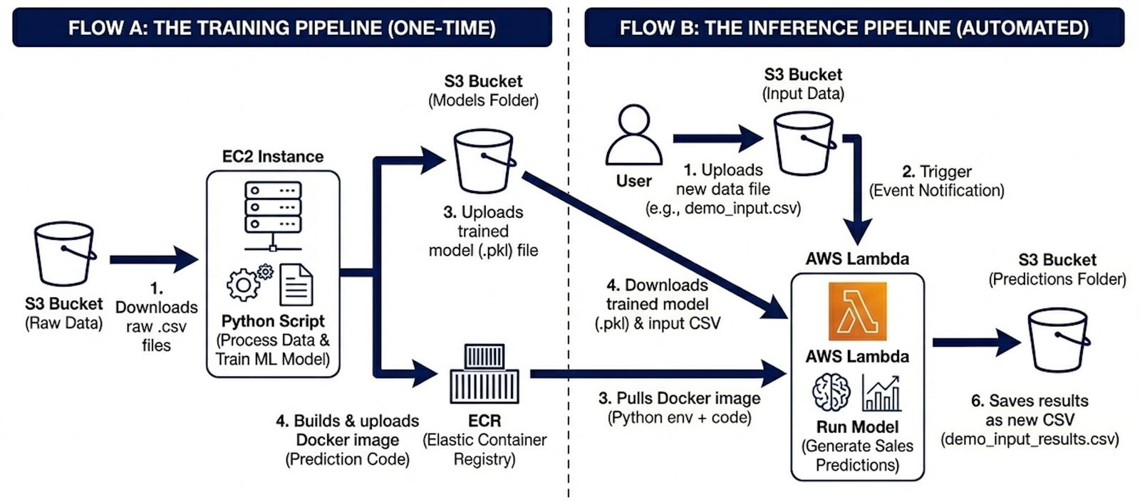
Data flows between the different AWS components
3. AWS infrastructure

Slide 11
4
Live Demonstration

Slide 12
5
Key takeaways

Slide 13





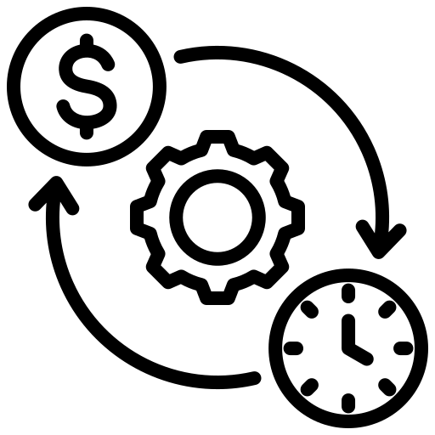
The solution can be improved in the future
5. Key takeaways
1
3
Key takeaways
Improvement possibilities
Cloud scalability: Project demonstrates the use of diverse AWS compute services to handle different workloads
Incorporation of external data: Adding of external signals such as local weather data, holiday calendars, or major local events
2
Add API gateway: Currently, the process is triggered by an S3 upload. Adding an API gateway would allow better access options
Impact of solution
Reduction of food waste: By generating more accurate demand forecasts, managers avoid overstocking and therefore food waste
Inventory optimization layer: Move beyond raw prediction numbers by building a layer that translates sales into actual order quantities
Operational efficiency: The “upload-and-forget” workflow removes the need for manual data processing

